Slide 1

IPL WINNER
PREDICTION
V. Surya
DA & DS

Slide 2

Project Overview
Objective
Analyze key IPL match factors
Develop and evaluate models
Tune and optimize performance
Compare multiple model types
Approach
Use machine learning with historical match data.
Ensure rigorous data management and training.

Slide 3
Dataset Understanding
Numerical Variables
Categorical Variables
Dataset Size
Win by runs
City, Venue
Win by wickets
Teams & Toss Decision
756 rows and 18 columns
Season
Match Result & Player Awards

Slide 4

Data Cleaning
Key Steps
Preprocessing
Handle missing and inconsistent data
Remove unwanted columns, standardize types
Encoding
Outlier Detection
Convert categorical data to numerical format
Check and manage extreme values

Slide 5
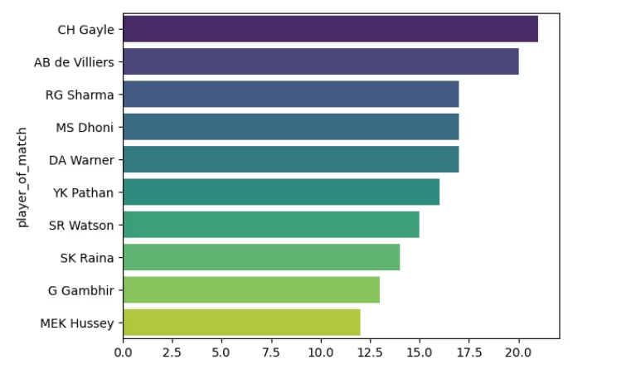
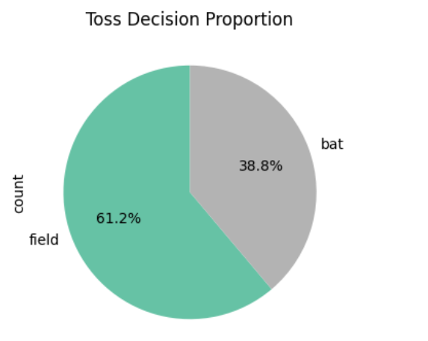
Exploratory Data Analysis: Univariate

Slide 6
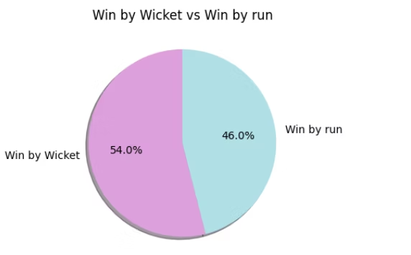
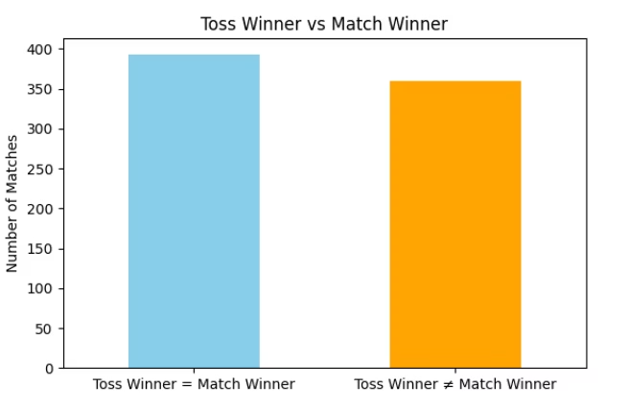
Exploratory Data Analysis: Bivariate
Comparison
Comparisons
Win_by_rusn VS Win_by Wicket
Match Winner VS Toss Winner

Slide 7
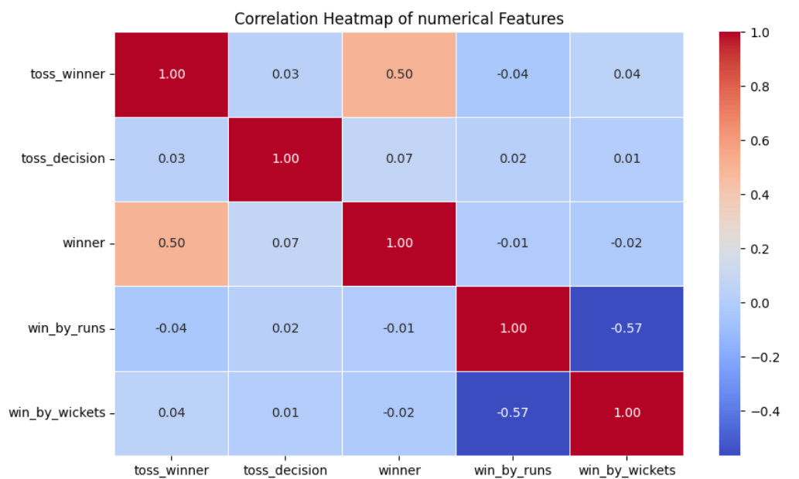
Exploratory Data Analysis: Multivariate
Complex Interactions
Assessing multiple factors' combined influence on outcomes

Slide 8
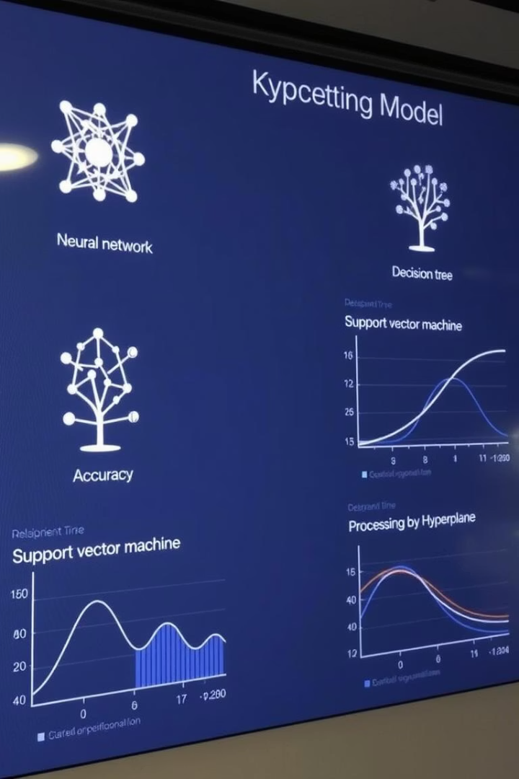
Modeling & Evaluation
Models Used
Evaluation Metrics
Logistic Regression
Accuracy & Precision
SVM, KNN, Decision Trees
Recall & F1-Score
Random Forest & XGBoost
Confusion Matrix Analysis
Optimization
Hyperparameter tuning via Grid Search

Slide 9
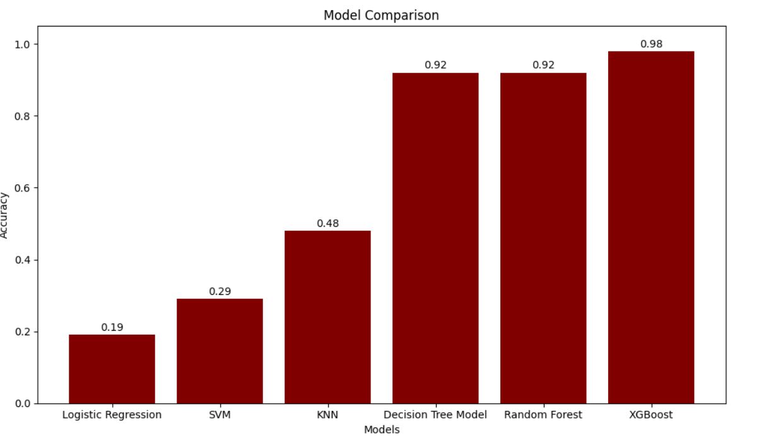
Model Comparison Results
Best Model
Efficiency
Highest accuracy and balanced F1-score
Optimized algorithm for speed and reliability
Impact
Reliable IPL match outcome predictions

Slide 10

Conclusion
Improve Model
Advanced feature engineering
Ensemble stacking
Cross-validation methods
Future Actions
Model deployment in real scenarios
Regular retraining with new data
Expand dataset for more accuracy

Slide 11
THANK YOU

